Slide 1

IEEE 802.11
ARCHITECTURE

Slide 2
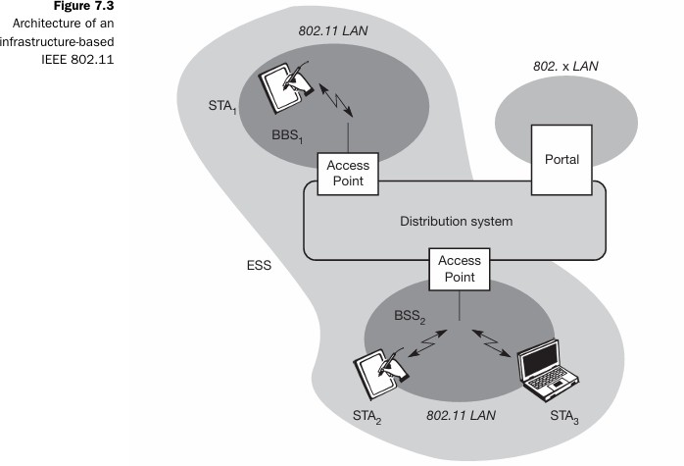
SHORT FORMS | FULL FORMS
LAN | Local Area Network
STA | Station
BBS | Baseband Station
ESS | Extended Service Set
BSS | Basic Service Set

Slide 3
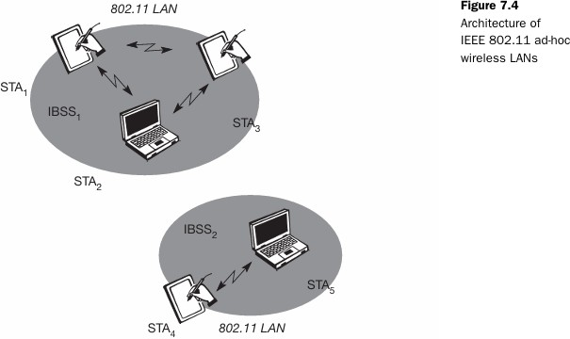
SHORT FORMS | FULL FORMS
LAN | Local Area Network
STA | Station
IBBS | Independent Basic Service Set

Slide 4
IEEE 802.11 PROTOCOL ARCHITECTURE

Slide 5
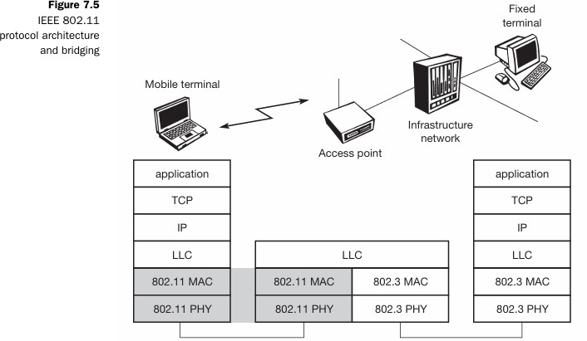
SHORT FORMS | FULL FORMS
TCP | Transport Control Protocol
IP | Internet Protocol
LLC | Logical Link Control
MAC | Media Access Control
PHY | Physical Layer

Slide 6
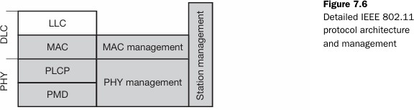
SHORT FORMS | FULL FORMS
DLC | Data Link Control
LLC | Logical Link Control
MAC | Medium Access Control
PLCP | Physical Layer Convergence Protocol
PMD | Physical Medium Dependent
PHY | Physical Layer

Slide 7
THANKYOU!

